Slide 1
Using Maps in Android Xamarin APP (VS2015/VS2017)
Google Map Api
https://developers.google.com/maps/
https://developers.google.com/maps/documentation/android-api/signup
Simple start
https://blog.xamarin.com/android-tips-faster-maps-with-google-maps-lite/
https://developers.google.com/maps/documentation/android-api/map
https://forums.xamarin.com/discussion/12887/adding-a-circle-with-google-maps-api
More
https://developers.google.com/maps/documentation/android-api/marker
https://developers.google.com/maps/documentation/android-api/views

Slide 2
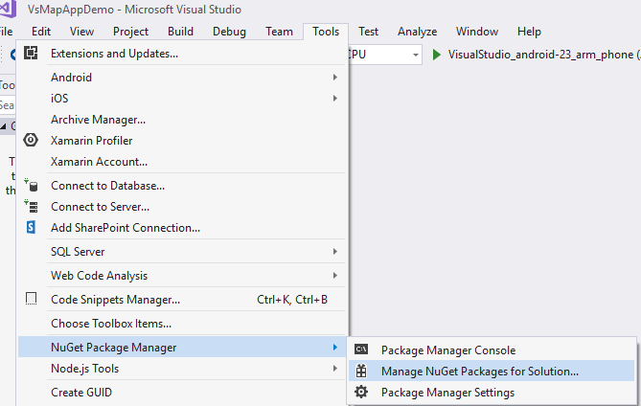
Add NuGet package for using GoogleMaps

Slide 3
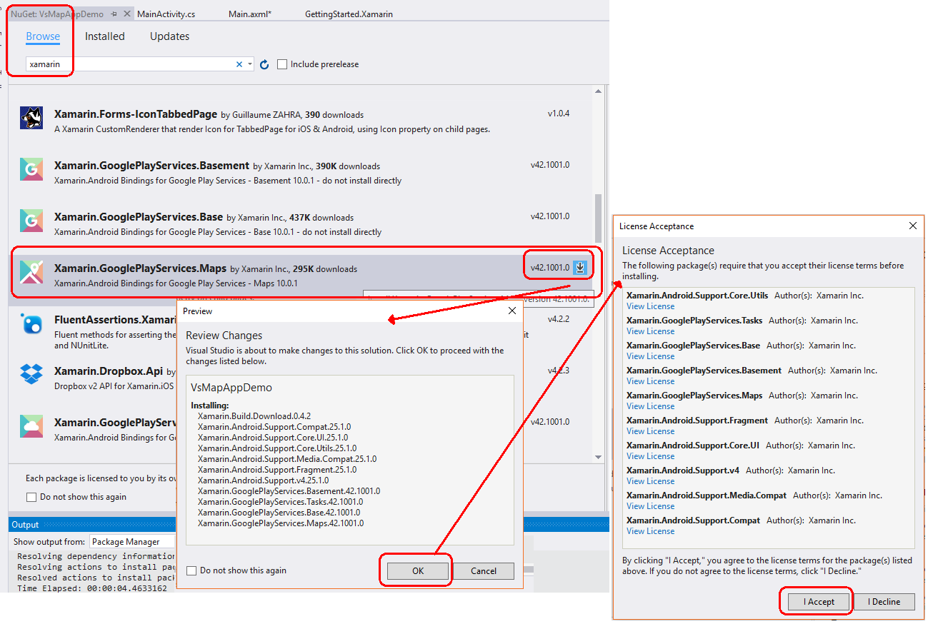
Add NuGet package for using GoogleMaps

